Slide 1

Team Name : Clawsome AI
Team Leader Name : Vaibhav Sugandhi & Aishwarya Pattar
Problem Statement : AI Analyst for Startup Evaluation

Slide 2

This prototype implements a startup investment analysis platform leveraging Google Cloud’s AI and analytics services. It demonstrates a modular Python workflow that:
Reads founder textual materials from a local file for analysis.
Uses Google Natural Language API to extract named entities and evaluate sentiment from the founder text, providing qualitative insights.
Uploads mock public startup data to BigQuery to build a dataset of startups and their funding.
Queries BigQuery to calculate average funding and startup counts for a specific industry, allowing quantitative benchmarking.
Combines sentiment analysis results and industry analytics to generate an insight report summarizing qualitative and quantitative signals.

Slide 3
Proposed solution details
Feature | Description | Use case
Text Analysis with NLP | Extracts entities & sentiment from founder materials | Enhanced qualitative insights
BigQuery Data Upload & Query | Stores and aggregates startup public data | Quantitative benchmarking
Cloud API Integration | Uses managed Google Cloud services | Scalability + reduces local overhead

Slide 4
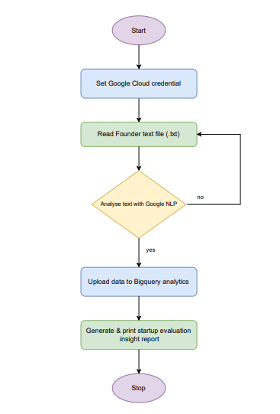
Process flow diagram

Slide 5
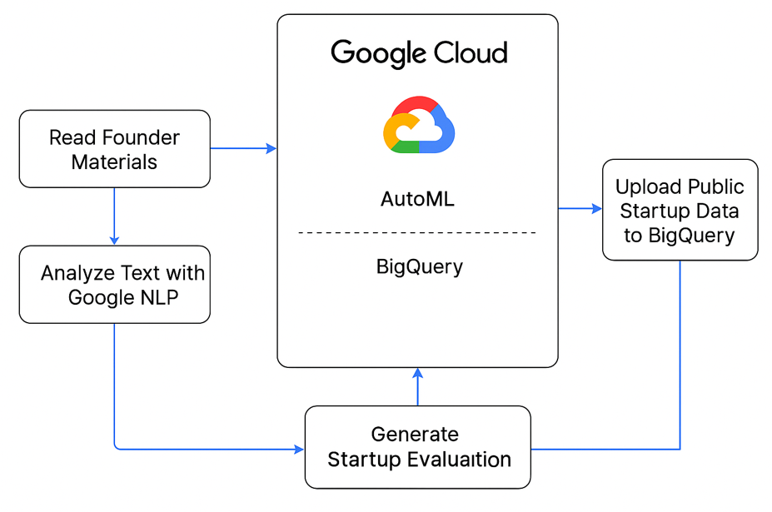
Architecture diagram of the proposed solution

Slide 6
Technologies to be used in the solution:
Google Cloud Client Libraries for Python: Official Python SDKs to interact programmatically with Google Cloud services (Natural Language API, BigQuery).
Google Service Account: Authentication mechanism using a JSON key file to authorize API requests securely.
Google Cloud BigQuery: Cloud-based data warehouse service to store, upload, and run SQL-like queries on public startup data for analytics.
Google Cloud Natural Language API: Provides advanced natural language processing capabilities such as entity extraction and sentiment analysis on founder text materials.
Command-line Interface (CLI): For user input (startup name) and console output of analysis reports.
Local File System Access: Reading founder materials from a local text file for processing.

Slide 7
Add as per the requirements for the hackathon:
GitHub Link - https://github.com/AalphaDemon/Startup_Evaluation.git

Slide 8


